Slide 1


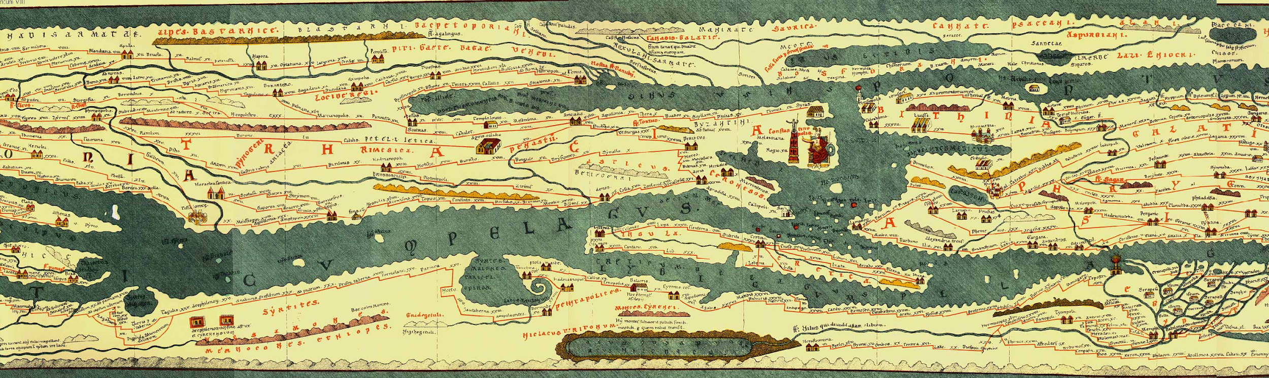
With the support of the Erasmus+ programme of the European Union. This document and its contents reflects the views only of the authors, and the Commission cannot be held responsible for any use which may be made of the information contained therein.
Data collection and analysis
(Entrepreneurship Section)

Slide 2
Objectives and Goals
At the end of this module you will be able to:
Identify a Market
Sample potential customers
Define tools to collect data
Analyze and interpret data

Slide 3
Unit 1. Decoding the territory: needs and opportunities
“A journey of a thousand miles begins with a single step”
-Laozi –
In the same manner, the entrepreneurial journey begins with a step into the territory. When starting a business, a young entrepreneur wants to know whether:
1.There is room and support for his/her idea;
2.There is a good chance for the business to grow;
3.Results are worth the effort;

Slide 4

Unit 1. Decoding the territory: needs and opportunities
Decoding the territory means analyzing the market in order to secure the future of a business idea. The potential size of a market defines market opportunities: knowing about the current customer base allows for safer choices.

Slide 5
Unit 1. Decoding the territory: needs and opportunities
3 elements of great relevance:
      • Market size. How many potential customers are available?
    • Profitability. Are potential customers willing and able to spend
    on the services of interest?
    • Potential growth. Are there signs, studies or sources the market size will grow, stay relatively static, or decrease?
Notes:
https://business.tutsplus.com/tutorials/define-analyze-a-market-opportunity--cms-31875

Slide 6
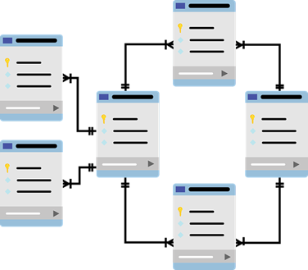
Unit 1. Decoding the territory: needs and opportunities
Often, important and helpful data are available out there. Bodies such as:
Government census and statistical data
Social media
Cultural tourism surveys and reports
Government agencies relevant to business
Market research report websites
collect and allow public consultation.

Slide 7
Unit 1. Decoding the territory: needs and opportunities
How to:
Consult public cultural tourism/entrepreneurship databases;
(e.g. data selection and extraction, cross-resource query)
Examine and interpret data;
(e.g. get insight from data comparison, as well as from graphical data representation)

Slide 8

Unit 1. Decoding the territory: needs and opportunities
Contextualize them into one’s own entrepreneurial idea
… By answering questions!
How much is spent on cultural tourism in the area of interest?
What is the average amount of customers of a cultural tourism initiative?
Who are they? Which of them would be the target of one’s offer?
Therefore, what would the income opportunity be?
Is there any cultural tourism-focused business already? If so, how many in the territory?

Slide 9
Unit 1. Decoding the territory: needs and opportunities
Consult public cultural tourism/entrepreneurship databases
Census data (e.g. government census and statistical data) come from official sources that track populations of interests (e.g. number of tourists registered in a date-time period, in a region). This kind of data is extremely precise, reliable and updated.

Slide 10
Unit 1. Decoding the territory: needs and opportunities
Consult public cultural tourism/entrepreneurship databases
Virtual Tourism Observatory:
https://ec.europa.eu/growth/tools-databases/vto/
Eurostat
https://ec.europa.eu/eurostat/statistics-explained/index.php/Tourism_statistics
European Travel Commission
https://etc-corporate.org/?page=research-intelligence
Notes:
For the virtual Tourism Observatory, the data source is Eurostat

Slide 11
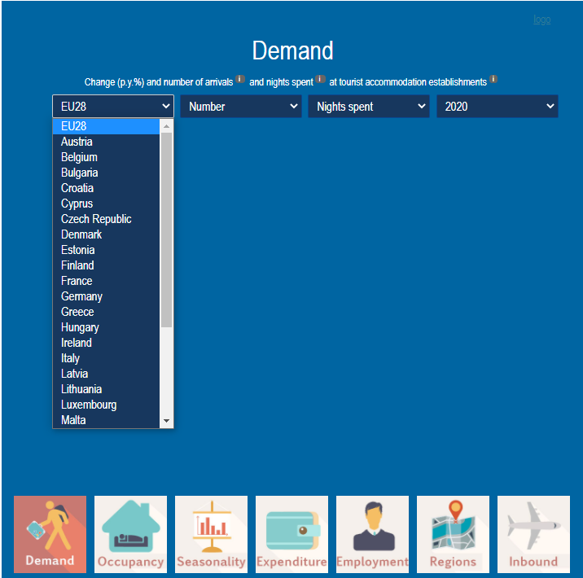
Unit 1. Decoding the territory: needs and opportunities
1.1. Virtual Tourism Observatory
Its aim is to support policy makers and businesses develop better strategies for a more competitive European tourism sector.
A first graphical data representation helps getting a first glimpse on what is going on in the sector. The visualization options are customizable, as well as the level (either the global EU or the country level) to be examined.
Notes:
For the virtual Tourism Observatory, the data source is Eurostat

Slide 12
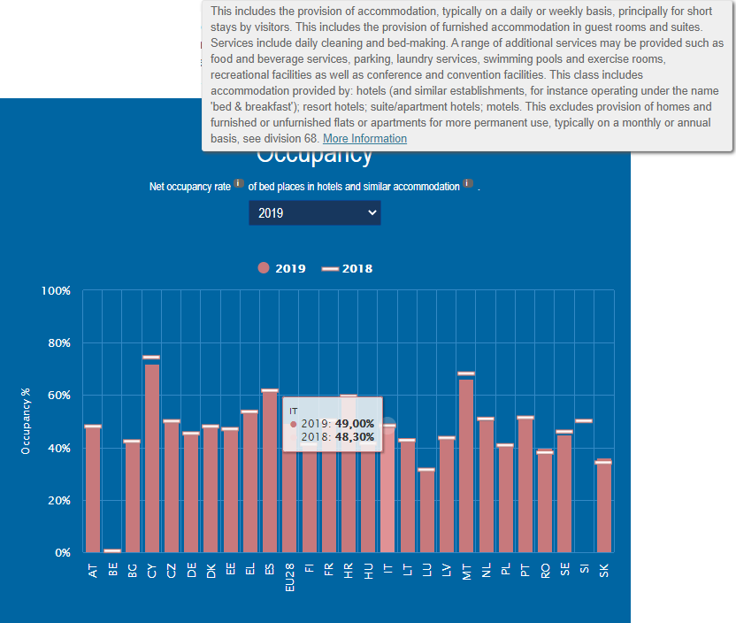
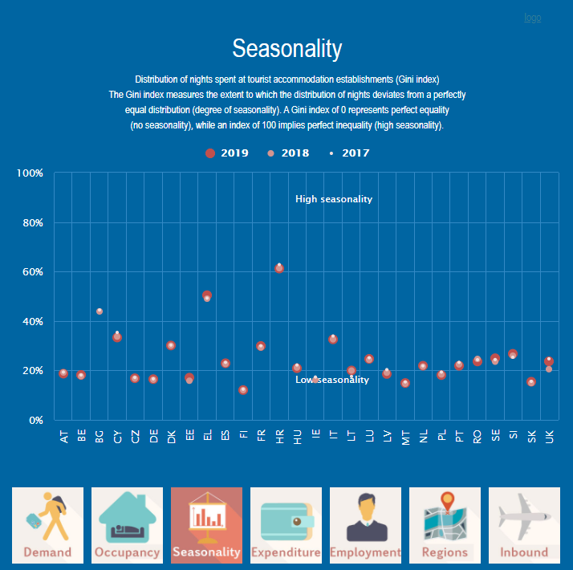
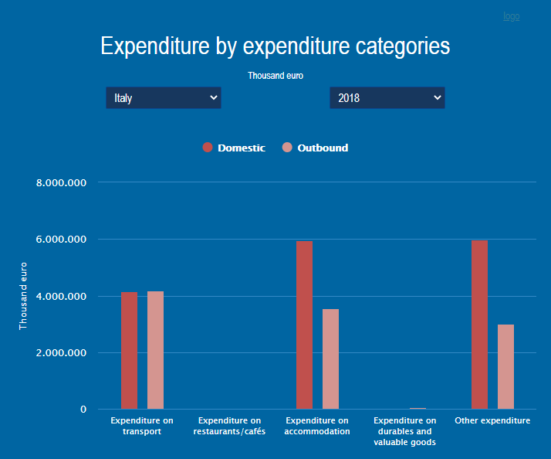
Unit 1. Decoding the territory: needs and opportunities
1.1. Virtual Tourism Observatory. Dynamic information about
The graphical representations (such as bars vs horizontal lines, points with different colors, different bars) allow comparisons and easy data interpretation.
Occupancy Seasonality Expenditure
Notes:
For the virtual Tourism Observatory, the data source is Eurostat

Slide 13
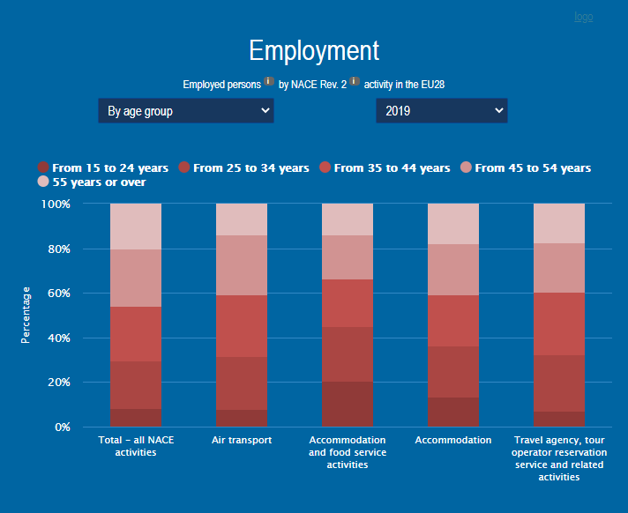
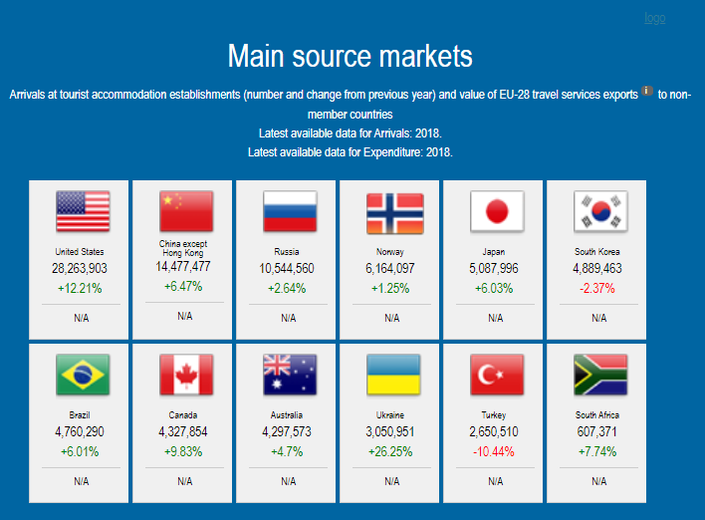
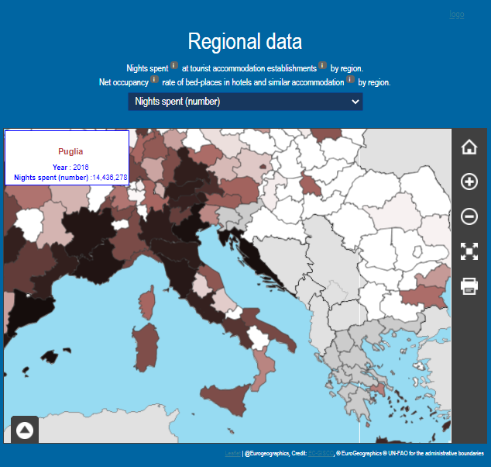
Unit 1. Decoding the territory: needs and opportunities
1.1. Virtual Tourism Observatory. Dynamic information about
The possibility to set up options and the responsiveness on the mouse click allows to narrow everything down and visualize information of interest
Employment Non-EU tourism presence Regional Data
Notes:
For the virtual Tourism Observatory, the data source is Eurostat

Slide 14
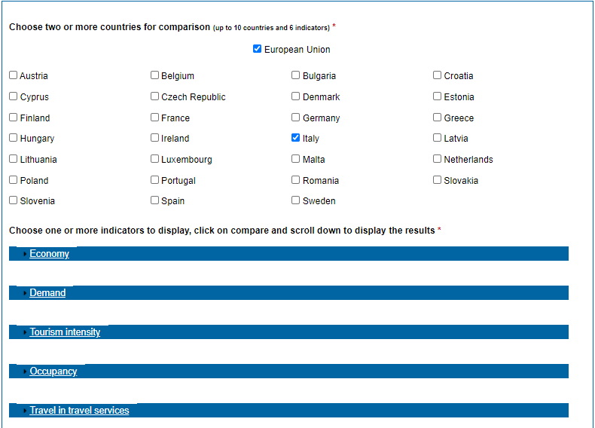
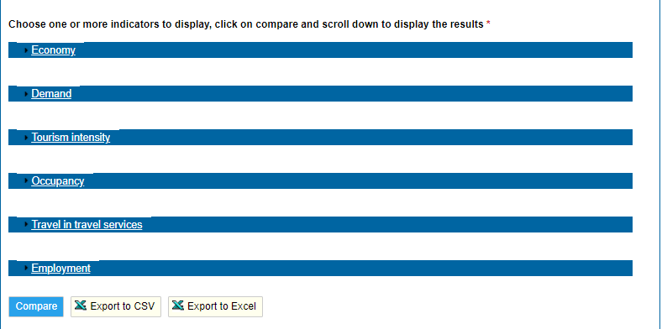
Unit 1. Decoding the territory: needs and opportunities
1.2. The VTO and the Eurostat database
The VTO website provides a Country Profile area. By clicking on it, you will have the possibility to customize the data of interest you want to collect. Data available in the VTO come from the Eurostat database.
Export your data!
Choose the country for comparison Select up to 6 indicators of interests.
Notes:
For the virtual Tourism Observatory, the data source is Eurostat

Slide 15
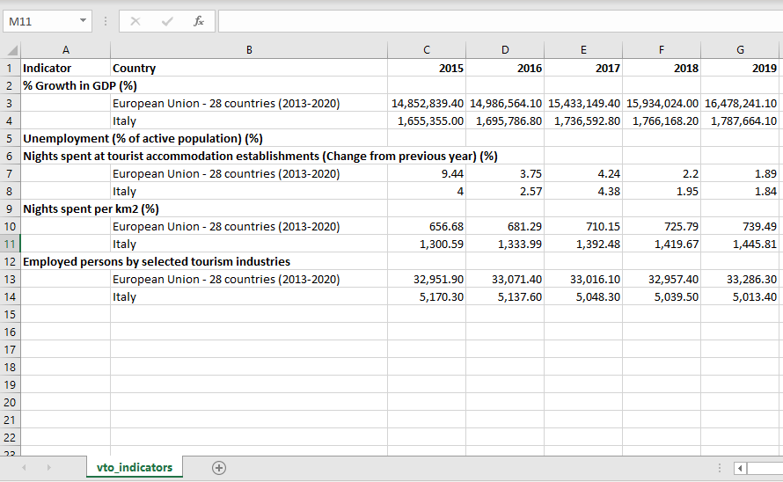
Unit 1. Decoding the territory: needs and opportunities
1.2. The VTO and the Eurostat database.
A ready-to-process
Excel Table
Notes:
For the virtual Tourism Observatory, the data source is Eurostat

Slide 16
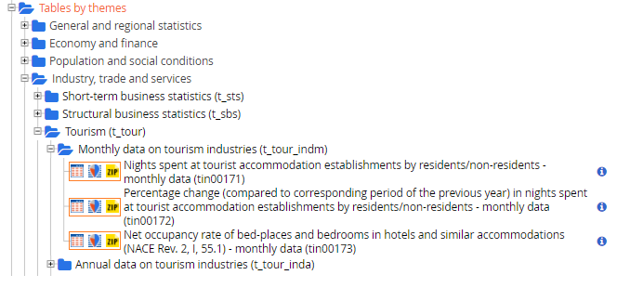
Unit 1. Decoding the territory: needs and opportunities
1.2. The VTO and the Eurostat database.
The Eurostat database is much larger, including more than just information about tourism. Its data might be crossed and looked at globally. You can search data by theme and timespan.
However, tourism patterns can largely vary across regions or local areas (especially in big countries). Therefore, you might want to refine (and redefine) your investigation.
Notes:
For the virtual Tourism Observatory, the data source is Eurostat

Slide 17
Unit 1. Decoding the territory: needs and opportunities
1.2. The VTO and the Eurostat database.
The Eurostat database is much larger, including more than just information about tourism. Its data might be crossed and looked at globally. You can search data by theme and timespan.
However, tourism patterns can largely vary across regions or local areas (especially in big countries). Therefore, you might want to refine (and redefine) your investigation.
The general and regional statistics section is what you need.
Notes:
For the virtual Tourism Observatory, the data source is Eurostat

Slide 18
Unit 2. Data gathering and processing methodology
Unit 2: Methodologies for gathering and elaboration data
Data Collection: sampling and sample size, official data, social media.
Survey Conduction
Methods for data analysis and visualization

Slide 19
Unit 2. Data gathering and processing methodology
Unit 2: Methodologies for gathering and elaboration data
Prior to any investigation, answer the 5 W and the H:
Who: Reference population (sampling)
What: Area/Topic under investigation, features of interest
When: timespan of interest
Where?
Why? Purpose
How? Data collection techniques

Slide 20
Unit 2. Data gathering and processing methodology
2.1. The sampling
Sometimes, the information one would need are not available in census data. Census data collection would be:
expensive
time consuming
less monitoring/control over the detection quality
for individuals/smaller bodies. Fortunately, sampling allows to estimate the population parameters/results/perceptions without going into the population detail. Sampling consists of extracting units from the population according to pre-established criteria that help generalize findings.

Slide 21
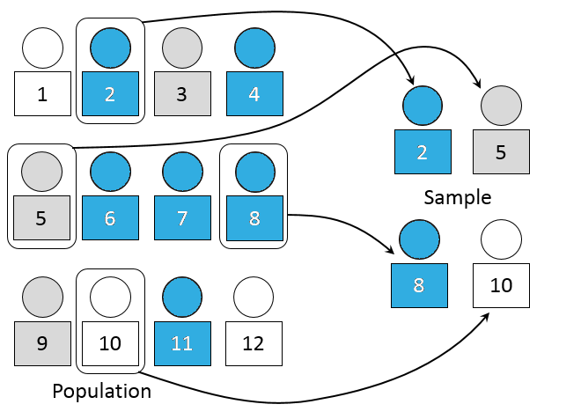
Unit 2. Data gathering and processing methodology
2.1. The sampling
Probabilistic
Every element has a known nonzero probability of being sampled;
Involve a random selection at some point;
In any probabilistic sampling method, the starting point is a list of the whole population
Simple Random Sampling: all the elements under investigation have the same probability of being part of the sample. Starting from a list of he whole population, the units are sampled randomly.
Systematic Sampling: the study population according is ordered and, after a random start, elements are selected at regular intervals through that ordered list

Slide 22
Unit 2. Data gathering and processing methodology
2.1. The sampling
Non-Probabilistic
some elements of the population have no chance of selection
(sometimes referred to as 'out of coverage'/'undercovered');
the probability of selection cannot be accurately determined;
Convenience Sampling: the sample is taken from a group of people easy to contact or to reach (useful in pilot studies);
Snowball Sampling: after finding a group of initial respondents, these are used to recruit more respondents;

Slide 23
Unit 2. Data gathering and processing methodology
2.2 Data collection technique
Standardized, valid and reliable tools (questionnaires, …)
Questionnaire:
Tool designed to collect information about aspects of interest (variables). How to build up a questionnaire?
3 steps:
Conceptual design
Questionnaire set-up
Questionnaire verification

Slide 24
Unit 2. Data gathering and processing methodology
2.2.1. Conceptual design
The 5 Ws and the H
2.2.2. Questionnaire set-up
Content Socio-Anagraphic information; Attitudes; Behaviors; | Form Open-ended question; Closed-ended questions;

Slide 25
Unit 2. Data gathering and processing methodology
2.2.2. Questionnaire set-up
Advantages and disadvantages of question form:
 | ADVANTAGES | DISADVANTAGES
OPEN-ENDED QUESTIONS | Freedom of expression, spontaneity. Useful when it is not possible to really anticipate possible answers. Useful for dealing with complex/delicate problems. | Too vague and difficult to understand Coding issues (e.g. generic or inaccurate answers) Answer quality depending on education level Individuals who are not used to conceptualized in written form penalized Demanding, high rejection rate

Slide 26
Unit 2. Data gathering and processing methodology
2.2.2. Questionnaire set-up
 | ADVANTAGES | DISADVANTAGES
CLOSED-ENDED QUESTIONS | Standardized (easy comparison). Easy coding. Multiple-answers help in clarifying the questions. Elicit truthful answers when it comes to sensitive data. Stimulate memory when focused on past events. The interviewee is facilitated. | The interviewee could provide random answers. The answers proposed may influence the response by excluding further alternatives. In long inquiries, the order of questions may influence respondents.

Slide 27
Unit 2. Data gathering and processing methodology
2.2.2. Questionnaire set-up
Questions formulation
Simple Language (avoid aulic/flowery language);
Simple Syntax (avoid double negative, avoid to require cognitive effort to the respondents);
Simple Content (investigate one feature at time, therefore avoid multiple statements in the same question)
Questions order
Easiest answers first;
Follow a logical order;
Open-ended/sensitive questions at the end;
Alternate length and type;

Slide 28
Unit 2. Data gathering and processing methodology
2.2.3. Verification
Evaluate:
            congruity between the measurement tool and the cognitive needs of the survey;
    functionality as a communication tool
    functionality as a useful tool for the interviewer.
Usually carried out through a pilot study, where the questionnaire is first administered to a reasoned sample.

Slide 29
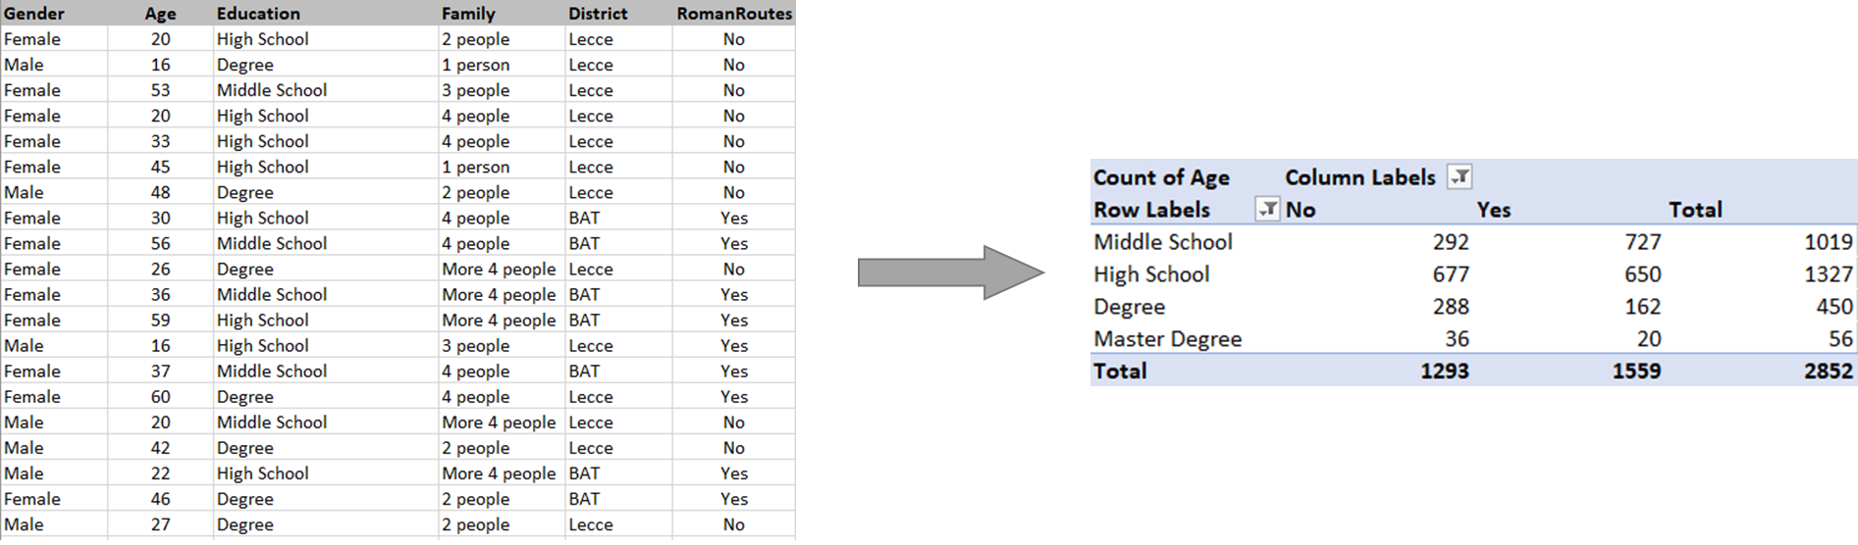
Unit 2. Data gathering and processing methodology
2.3 Data Analysis by using Pivot Table in Excel
Pivot tables are interactive tables that allow the user to group and summarize large amounts of data in a more concise format. Pivot tables are built from a list of data by using some classical formulas in Excel, like sum, mean, min, max. In this tutorial we will use simulated survey, designed as if the data was collected in the Apulia Region.

Slide 30
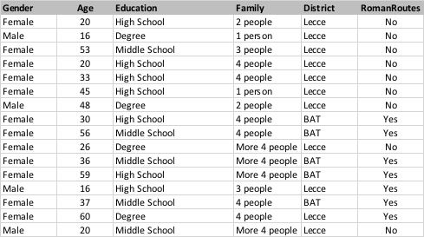
Unit 2. Data gathering and processing methodology
2.3 Data Analysis by using Pivot Table in Excel
In order to create the pivot table, the spreadsheet with database must have the following characteristics:
Having a column with duplicate values (e.g. Gender).
Contain numerical values (e.g. age) to compare or add. Otherwise the only possible statistic is the count.

Slide 31
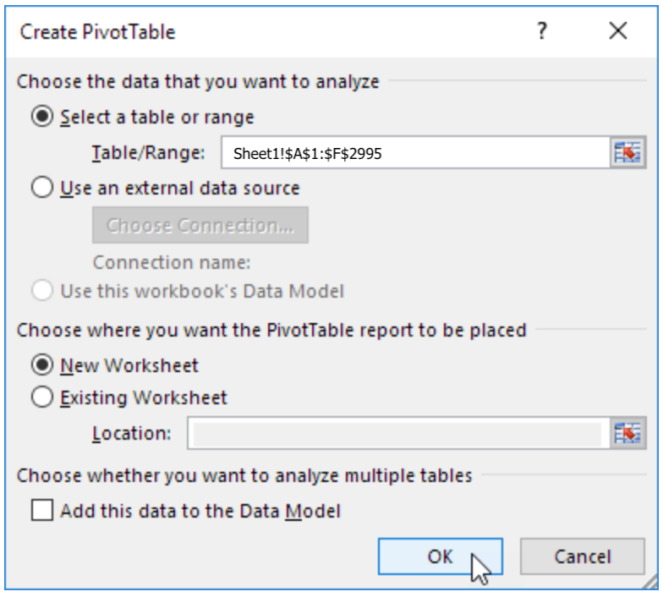
Unit 2. Data gathering and processing methodology
You can change data selection
2.4. Create Pivot Table
Click on Insert Tab and then click on Pivot Table
Excel will select all your data, but you can change the selection.
Create the Pivot Table on a new worksheet.
Click on OK button to create your Pivot Table.
You can use the worksheet you have the DB

Slide 32
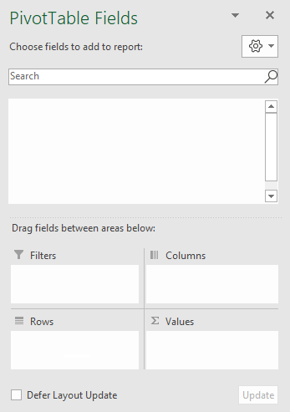
Unit 2. Data gathering and processing methodology
2.4. Create Pivot Table
The Fields of a Pivot Table are mainly 3! Rows, Columns and Values. An extra field is used to define filters. To obtain the mean age of the interviewed considering Level of Education and if is close to a Roman Routes, drag the fields in following boxes:
Education in Rows Box
RomanRoutes in Columns Box
Age in Values Box and select Average

Slide 33
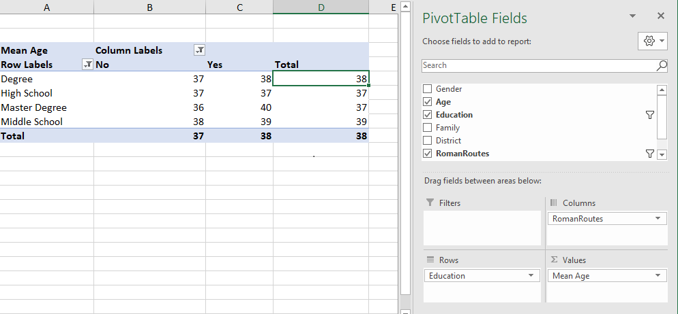
Unit 2. Data gathering and processing methodology
2.4. Create Pivot Table
Here the result. Since there is no big differences in term of mean age among the groups defined by using Education and RomanRoutes. It could be interesting to evaluate the amount of people that leave near a Roman Routes. You can do that by clicking on the symbol in the
Values box, then modifying its Field Settings. Here, you can select Count.

Slide 34
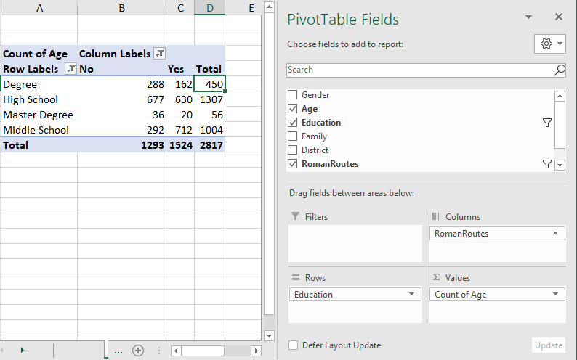
Unit 2. Data gathering and processing methodology
2.4. Create Pivot Table
The table obtained tell us the number of people that leave near a Roman Route with information about the education level.
This could help to decide the type of business or sector. For instance cultural business, entertainment, food.

Slide 35
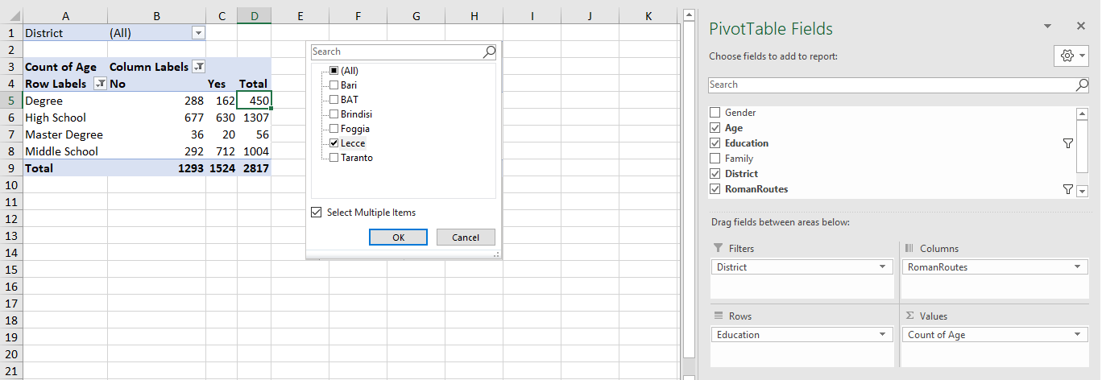
Unit 2. Data gathering and processing methodology
2.4. Create Pivot Table
It is possible to add filters.
Drag in the box Filter the variable District. You will obtain an extra window that allows to select (or deselect) the statistical units in Districts of the Apulia Region.

Slide 36
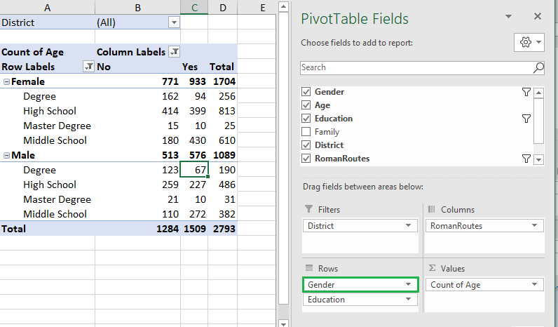
Unit 2. Data gathering and processing methodology
2.4. Create Pivot Table
It is possible to add extra fields. Drag in the box Rows (you can drag as well in the box columns) the variable Gender.
This option will give extra information about the data, by going in deep in the gender differences of the sample analysed.

Slide 37
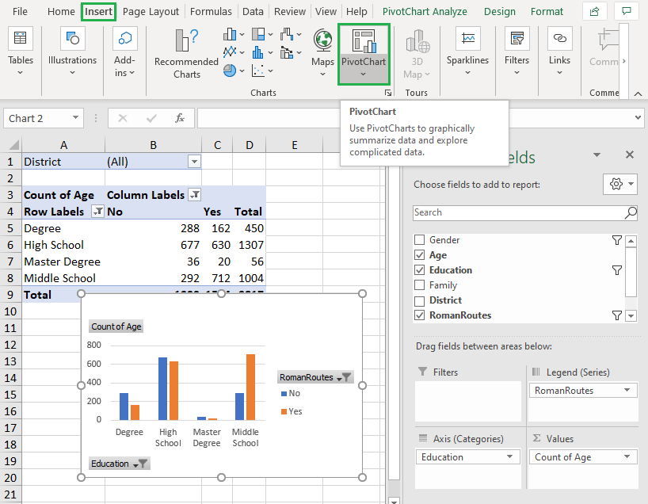
Unit 2. Data gathering and processing methodology
2.4. Create Pivot Table
It is possible to create a Pivot Chart.
To insert the chart, follow these steps:
Select any cell of the Pivot Table.
In the Insert tab click on Pivot Chart button.

Slide 38
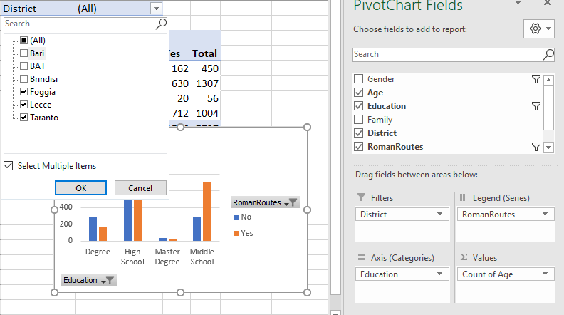
Unit 2. Data gathering and processing methodology
2.4. Create Pivot Table
You can add filter just by following the previous step for the Pivot Table. By adding the filter to the Pivot table you will add filter to the Chart.

Slide 39
Unit 2. Data gathering and processing methodology
2.4. Create Pivot Table
The coolest thing about the Pivot table is certainly its dynamicity!
Dynamic means it may get automatically updated. Let’s say you may need to add further data (perhaps, more recent data) to your table: you will add rows (that is, observations) to your raw table (the one containing the original, individual data). After done that, all you have to do is to Change the
Data Source (by extending the selected area to the rows added).

Slide 40
Unit 2. Data gathering and processing methodology
2.4. Create Pivot Table
Once you update the Data Source, both the tabular and the graphical summaries will be automatically updated.
Getting meaningful insight on how to make the most out of
the Roman Routes nearby your area has never been so easy!

Slide 41
Thank you for your attention!
With the support of the Erasmus+ programme of the European Union. This document and its contents reflects the views only of the authors, and the Commission cannot be held responsible for any use which may be made of the information contained therein.

